Slide 1

The Finance Department of ABC Company
Presented by : Koffi Offori Christian
Last updated : October 22, 2021

Slide 2
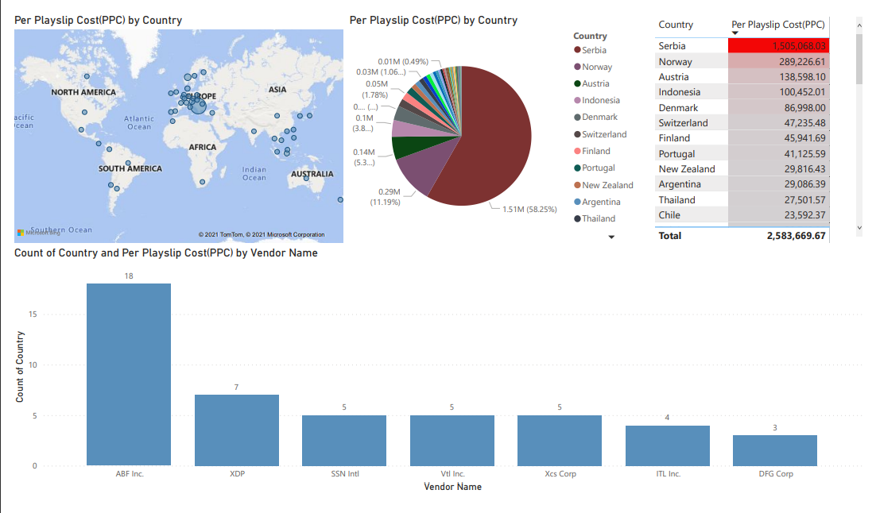
Table contents
The purpose statement is to collate all the Region-specific sheets in one file, clean all unwanted data and map it with the other master tables and create an automated dashboard solution that can serve all.
This dashboard shows us a bit the state of each different Country-level Finance leaders by the means of Per Payslip Cost (PPC).
Conclusion

Slide 3
Understanding the problem
Business Case
Problem statement
Data set description
The Finance Department of ABC Company maintains the invoice level details of all Payroll vendors and the cost associated with generating payslips for their employees. The Analyst receives invoices for each vendor and he fills all the details from each invoice in an excel sheet. He along with his colleagues collects similar data for all the countries and collates that information in one spreadsheet. The Global Finance leader along with other Country-level Finance leaders seeks data from these analysts to identify the Per Payslip Costs (PPC), that helps them in negotiating with vendors to reduce overall cost for the company.
Since data is being captured for different regions by separate analysts there is no way the Global leader could view the real-time global metrics, he has to wait for all the Country/Region-specific leaders to share their metrics with him and it only happens once a month. Your manager has got a request to build a global dashboard with some key metrics, that can be one source of truth for all regions. Your manager has assigned this task to you to collate all the Region-specific sheets in one file, clean all unwanted data and map it with the other master tables and create an automated dashboard solution that can serve all.
Country-wise Detailed information on Vendor Charges/fees ( Regional Table1, Regional Table2)
Country-wise Payslip Information (Payslips)
Master Mapping table – Country – Region – Vendor Name (Mapping)
Summary Table consists of Monthly summary of cost as well as payslip information

Slide 4
Objective :
Identify the Per Payslip Cost (PPC) value to help country level finance leaders negotiating with vendors in order reduce overall cost of the company.

Slide 5
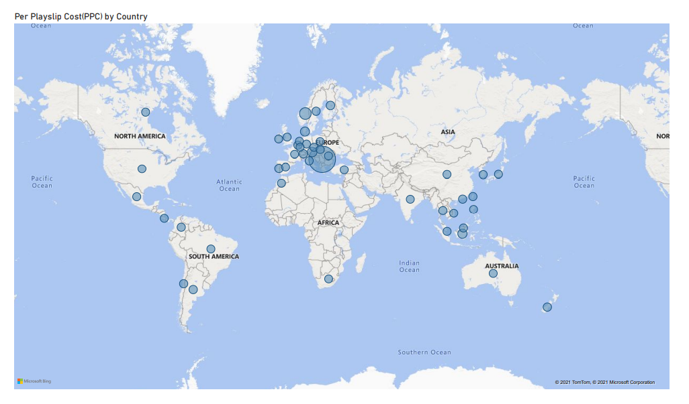
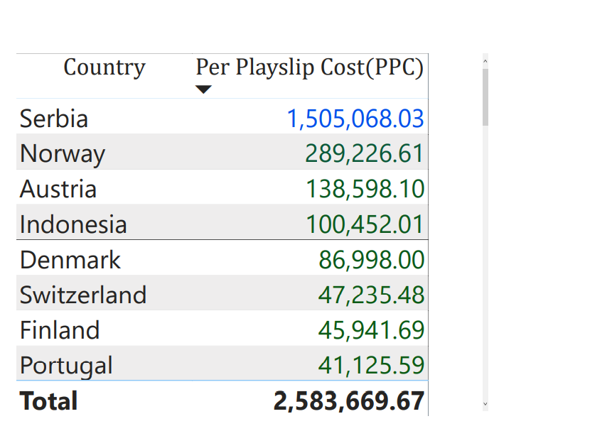
simple explanation of the country with the Highest PPC value in different country level finance.

Slide 6
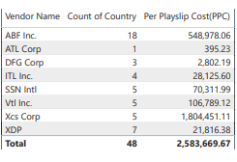
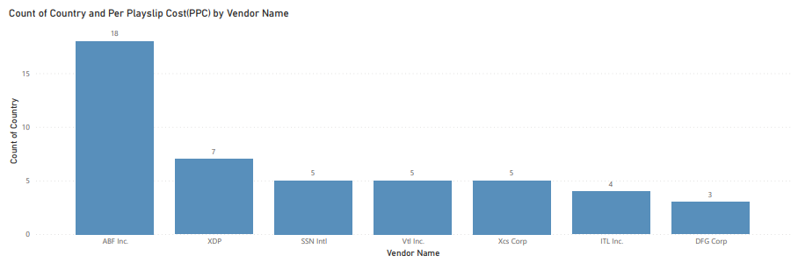
On the classic bar chart below we can observe that all vendors catering to more than one country have almost the same Per Playslips Cost(PPC) values apart from ABF Inc. vendors which is obviously the huge one with 18 countries in its palette counter.

Slide 7
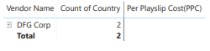
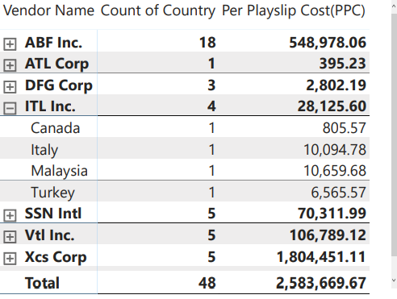
So, as shown here down right to this Matrix Chart we conclude that there is one vendor GFG corp who caters to more than 1 country and hasn't reported any invoice in 2 countries Greece and Russia.

Slide 8
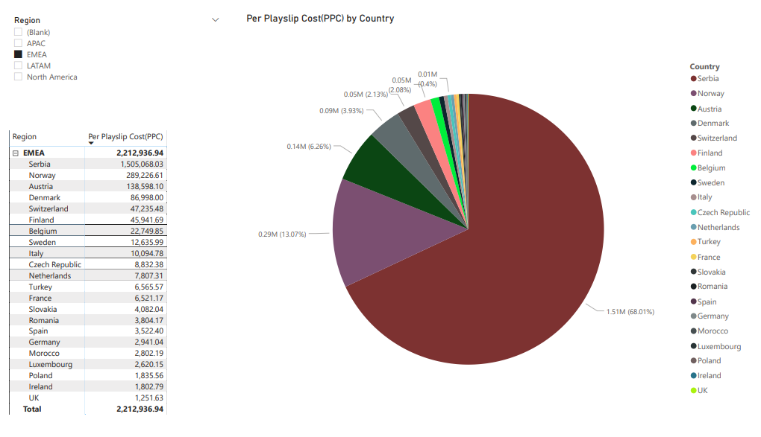

Slide 9
Conclusion
Since the PPC = total amount / payslip count We can suggest two ways to reduce PPC value in Serbia.
First, The Finance Department of ABC Company in Serbia could increase number of payslip count in other to be hugely greater than the total amount charged in the invoice.
Second, The Finance Department of ABC Company in Serbia could decrease number of total amount in other to be hugely less than the payslip count generated for that month.
Therefore, as a headcount generate payslip, we can add more headcount to reduce the number of PPC in Serbia.

Slide 10


The Team
Offori K.
Bachelor student at ITM university

